Slide 1


Zoo Project
Software Design 2 By Nick Sellinger

Slide 2


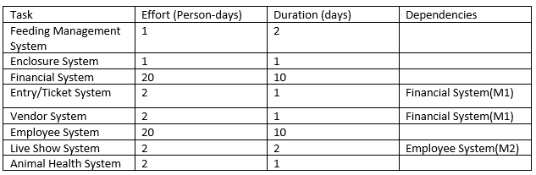
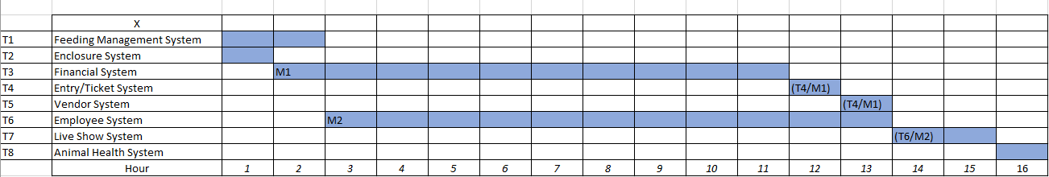
Project Proposal The Beginning
Original confusion with Effort.
Excel Sheet Timeline

Slide 3


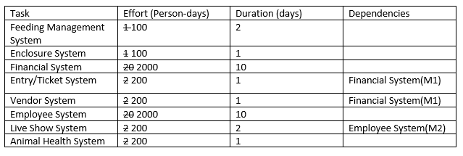
Project Proposal (Revised)
Person-days was incorrect And corrected to fit the estimation.

Slide 4
Downloading GIT (Sort of)
Already downloaded from previous class
Account already created

Slide 5
Creating the Detailed design
Major Objects:
Audit- logTransaction(), forwardCharge()
Timecard- beginTimer(), stopTimer, logHours()
HealthRecord- records(), updateRecords(), pastTreatments()
FeedingSchedule- dietList(),getSchedule() markTime()
FinancialStystem- getPrice(),chargeCustomer(), calcReceipt() payEmployee()
UserInterface-sendInfo(), requestInfo()
Use Cases, and lack of attributes.

Slide 6
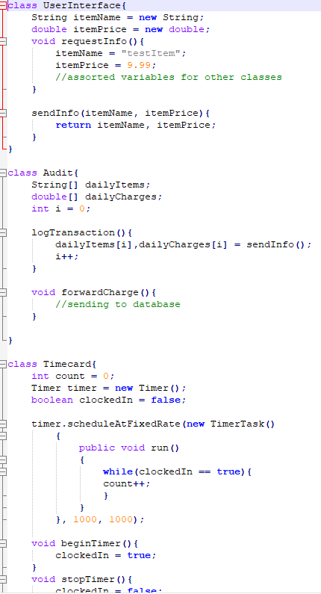
Writing Rough Code

Slide 7

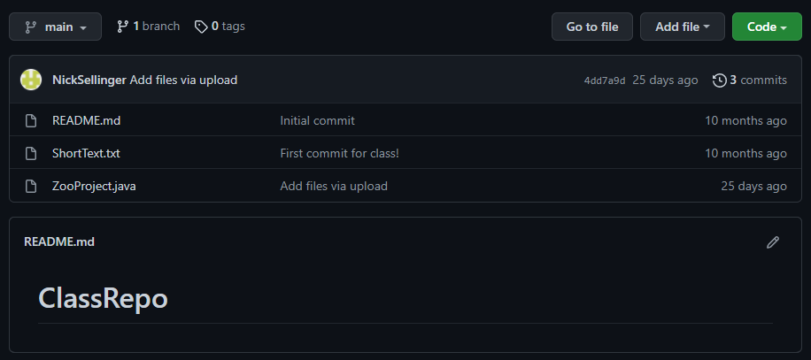
Uploading to GIT

Slide 8
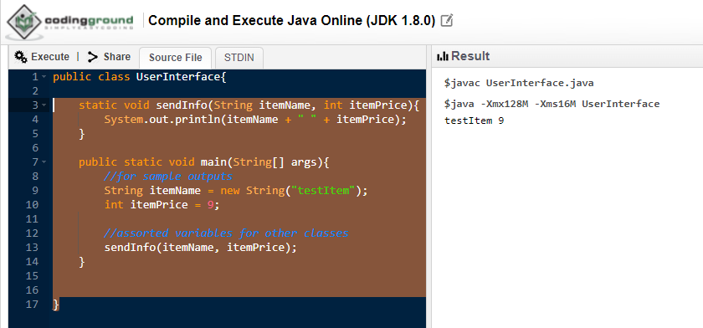
The Test Procedures
The ordeal of Testing
Revising my code for testability Finding a way to test the code

